Slide 1
Slope Intercept Form
Unit 2.2
Graphing Linear Equations

Slide 2
Vocabulary Unit 2
Linear Equation: An equation with two variables that describes a straight line when plotted on a graph.
Example: Identify (circle) the linear equations.
A) y = 2x + 5 B) 6y² = 8
C) √12 = y D) 7y = 5 – x

Slide 3
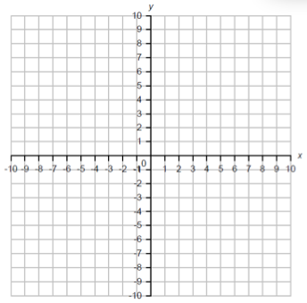
Vocabulary Unit 2
Slope: The “Rise over Run”. The slope describes the steepness of a line. It is written as a fraction: rise/run.
Example:
Run
Slope =
Rise

Slide 4
Vocabulary Unit 2
Positive & Negative Slope: If the graph of a line goes up-hill from left to right the slope is said to be positive. If it goes down-hill left to right then it is said to have negative slope.
Example:
Negative
Positive

Slide 5
Vocabulary Unit 2
y-intercept: Where the graph of a line crosses the y-axis, at point (0, y).
Example:
(0, 4)

Slide 6
Vocabulary Unit 2
x-intercept: Where the graph of a line crosses the x-axis, at point (x, 0).
Example:
(-3, 0)

Slide 7
Vocabulary Unit 2
Slope Intercept Form: A linear equation written in the form y = mx + b.
* The slope of the line is m.
* The y-intercept is b.
Example: In the equation y = ½ x + 3, the slope is ½ and the y-intercept is 3.

Slide 8
Vocabulary Unit 2
Graphing Linear Equations using the Slope-Intercept Form: Using what we know about the slope and y-intercept of a line to plot it on a graph.
Step 1) Plot the y-intercept
Step 2) Plot more points using the slope
Step 3) Draw the line by connecting the dots

Slide 9
Example:
y = mx + b
Step 1: If we know that the y-intercept is 3, then we can plot the point (0, 3) on the graph.
Step 2: From that point, we count the “rise and the run” of the slope to find other points on the line.
Step 3: Connect the dots.

Slide 10
y = mx + b
y = mx + b
Step 1: Plot the y-intercept point. In this case b = -5. The ordered pair is (0, -5).
Step 2: From that point, we count the “rise and the run” of the slope to find other points on the line.
Step 3: Connect the dots.
Let’s try another one!

Slide 11
The examples so far have
both had positive slope.
What would the graph of
a line with negative slope
look like?

Slide 12
y = mx + b
y = mx + b
Step 1: Plot the y-intercept point. In this case it is, what?
Step 2: The slope is
what?
This time the “rise” is negative so we must go down three! The “run” is the same as always, to the right four.
(0, 6).
Let’s try this one!
-3/4.
Step 3: Connect the dots.

Slide 13
Try These! ☺
y = mx + b
y = mx + b
y = 2/5 x - 3
y = -1/4 x + 8

Slide 14
Here’s Two more!
y = mx + b
y = mx + b
y = 3x - 4
y = -2x +7

Slide 15
Now, Let’s Compare…
y = mx + b
y = mx + b
y = 2/3 x +2
y = 6/9 x - 8
They’re PARALLEL!

Slide 16
Back to Vocabulary!
Parallel: Two lines that do not intersect. Two lines are parallel only if they have the same slope!
In the first equation, the slope was 2/3.
In the second, the slope was 6/9…
which is equivalent to 2/3!
So, these two lines are PARALLEL! ☺
But WHY?

Slide 17
Homework Time! ☺
Slope-Intercept Graphs WS
(both sides, all problems, show your work!)

