Slide 1
Classroom Rules and Procedures 101
Mrs. Sant’s

Slide 2
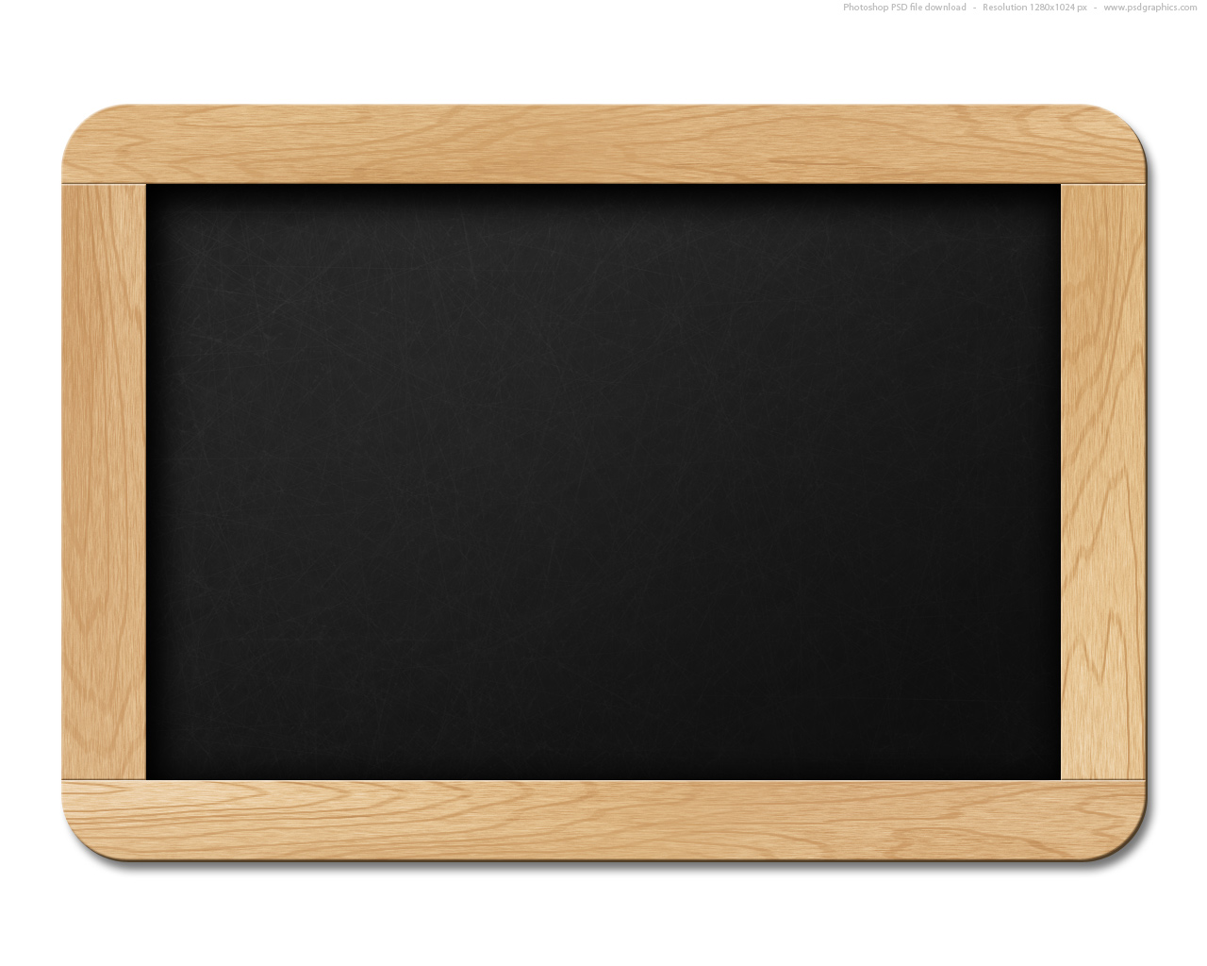
Welcome to Mrs. Sant’s class! Class Rules
Do what the teacher asks/be on
task.
Use appropriate language
Keep hands/body/objects to self.
Be on time, prepared and ready
to participate.

Slide 3
Classroom Procedures

Slide 4
How to enter and start class
Students will perform bell work immediately after entering the classroom.
Enter class respectfully
Starter will be in basket OR
You may have question of the day on the board
If you have a question of the day—answer the question and put it in the yellow basket on Mrs. Sant’s desk
Then you will do the starter

Slide 6
Meetings
All students will participate in class meetings.
Get in a circle quickly
Speak when you are holding the “stick”
Offer a compliment or appreciation OR
Accept a compliment or appreciation
Business items

Slide 7
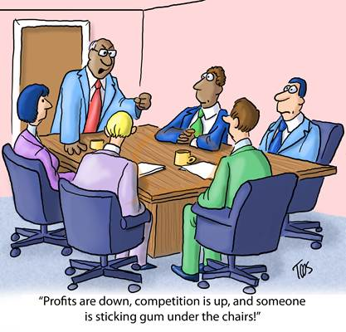

Slide 8
Potty Pass
Students will request permission, only if absolutely needed, to use the hall pass for maximum of five minutes.
10 minutes, student marked tardy
15 minutes, student is marked absent
Emergencies excluded (of course)

Slide 9
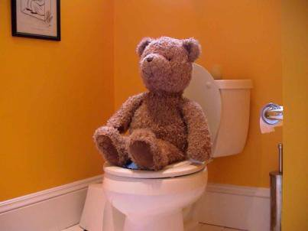

Slide 10
The Bell is going to ring, what do I do?
Students will remain in their assigned desks at the end of the class period until the teacher dismisses class.
calculators are turned in
desks are straightened
papers on the floor are picked up
You get to wait and leave last if you line up at the door before being excused.

Slide 11
Notice the students are waiting for the teacher to excuse them!

Slide 12
Seat Time
Students will remain seated in their desks during class unless given permission to do otherwise.
What an obedient child

Slide 13
Students will respond immediately to teacher request for attention

Slide 14
Talking? (of course, when appropriate)
Students will raise their hand and wait for permission to talk unless otherwise assigned (i.e. when doing group or partner work).
The following applies if I have to stop instruction because you are talking.
First offense: Warning (unless behavior is continual)
Second offense: Student sent to back of classroom or change of seat.
Third offense: Student is sent to hallway for teacher conference/ perhaps parent is contacted.
After that: Referral to VP.

Slide 16
What do I do if I finish early?
If students finish early, they may
a) read
b) work on an assignment for another class
c) write
d)draw
e) work on the class puzzle
f) do something else appropriate with teacher permission

Slide 17
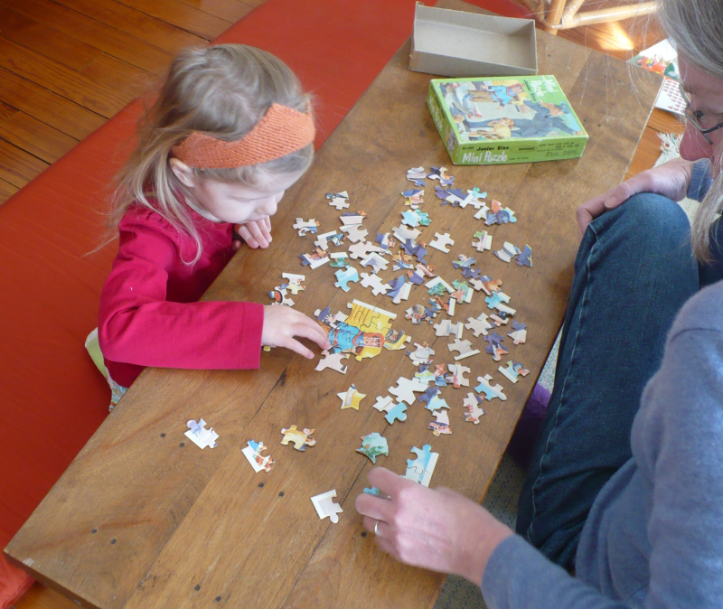

Slide 18
But I was absent….(wah wah wah)
If absent, students will get notes and assignments from the class website or another student
complete the assignment
and turn in within a week to get credit.
TESTS CAN BE MADE UP FOR ONE WEEK AFTER A STUDENT RETURNS TO SCHOOL.

Slide 19
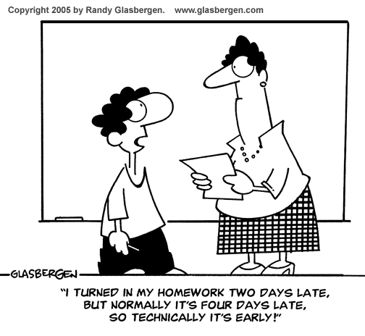

Slide 20
Frequently Asked Questions (FAQs)

Slide 21
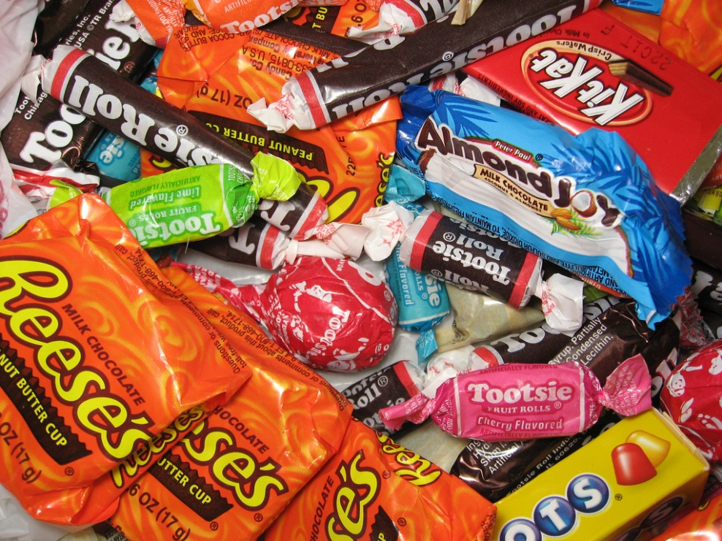
Can I eat food during class?
Yes, if you bring enough for everyone and share.

Slide 22
Can I bring a drink to class?
Yes. As long as it is water!
A drink other than water will be placed on the back counter for the class period.

Slide 23
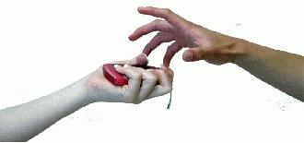
Can I text or call someone during class?
Yes, if you want your phone taken away.
If you are using your phone in class, you will be asked to give it to the teacher for the class period.
If you are defiant about the giving the phone to the teacher, the hall monitor will be called to come and take it; then the VP may give it to you after school, or they may call a parent to come and pick it up.

Slide 24
Can I listen to my I-pod?
Yes, after a test and during individual work time.
If you have your headphones in your ear during teacher instruction, your IPOD is given to the teacher until the end of the period; or given to the hall monitor or VP

Slide 25
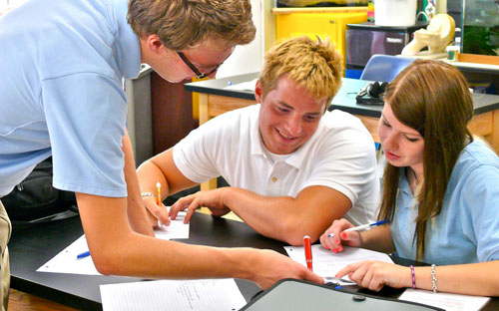
Can I move to sit by my friend to work together?
Yes-- when specified by the teacher.
Students sitting together to do their work (unless specified by the teacher) will get a zero on the assignment.

Slide 26
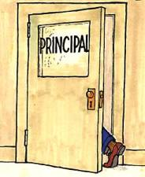
Can I make an inappropriate comment?
(examples: calling out, crude or foul language, rude comments to other students or teacher)
See consequences for talking in class. With serious violations, student is sent directly to VP.

Slide 27
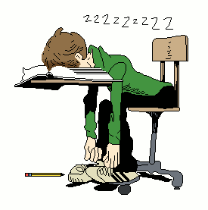
Can I sleep in class?
If you want to miss out on instruction and lose points.
If sleeping, student will not be allowed to make up that in class assignment..

Slide 28
Can I throw objects at others or the garbage?
NO, Why not?
Student picks up fifteen pieces of paper/trash from the floor.

Slide 29
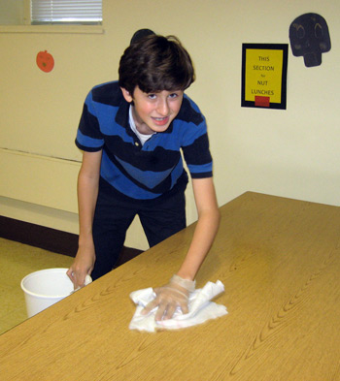
Can I write on the desk?
No
Student cleans all desks in the classroom.

Slide 30
Do I need to bring a pencil every single day?
Of course, so you can
participate.
Students can trade a
personal belonging to
borrow a pencil/pen
if the teacher has one.

Slide 31
What happens if I do what is expected?
You get the satisfaction of a job well done.
Good grades
Students’ parents and teachers are pleased
Student feels good about themselves.
You might even get a positive note or phone call home!

