Slide 3
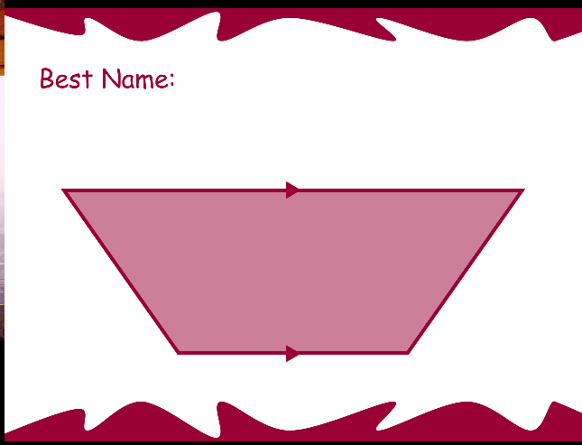
Trapezoid

Slide 4
Square
This is also a:
Parallelogram
Rectangle
Rhombus

Slide 5
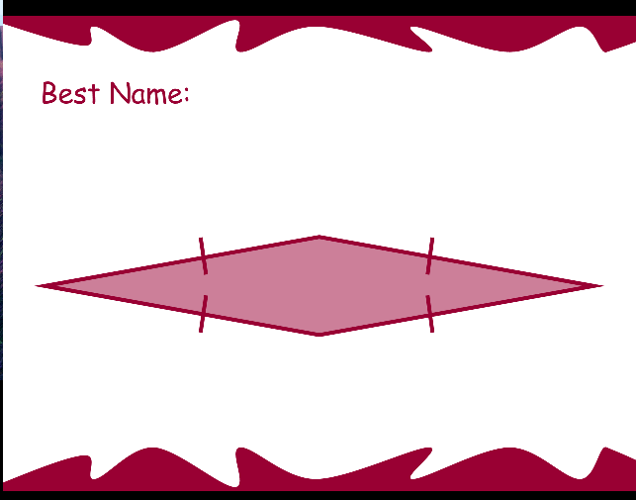
Rhombus
This quadrilateral is also a
Parallelogram

Slide 6
Quadrilateral

Slide 7
Rectangle
This Quadrilateral is a parallelogram with four right angles.

Slide 8
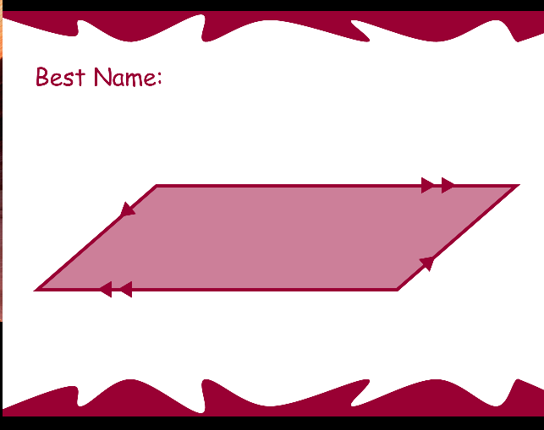
Parallelogram

Slide 9
Trapezoid

Slide 10
Quadrilateral

Slide 11
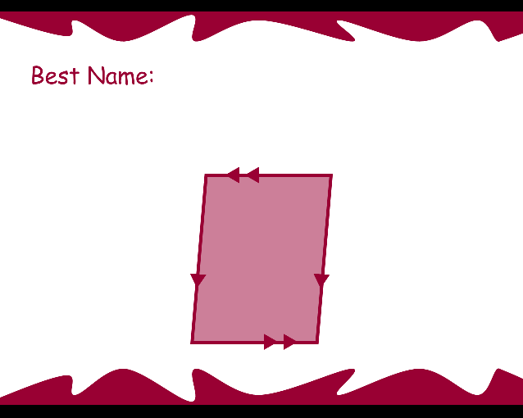
Parallelogram

Slide 12
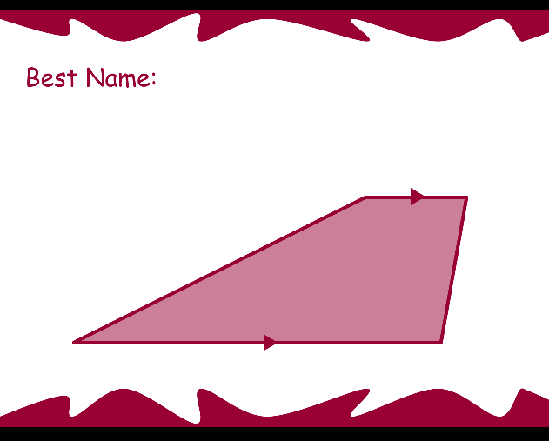
Trapezoid

Slide 13
Rectangle
A rectangle is a quadrilateral with four right angles.

Slide 14
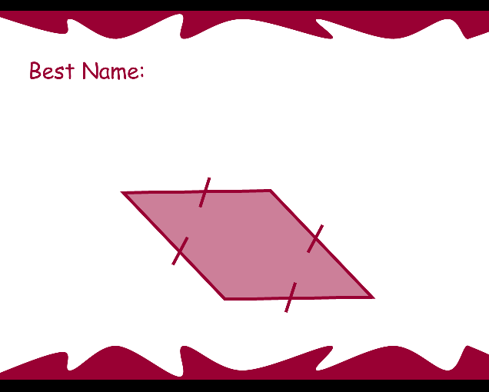
Rhombus
A Rhombus is a quadrilateral with four equal sides.

Slide 15
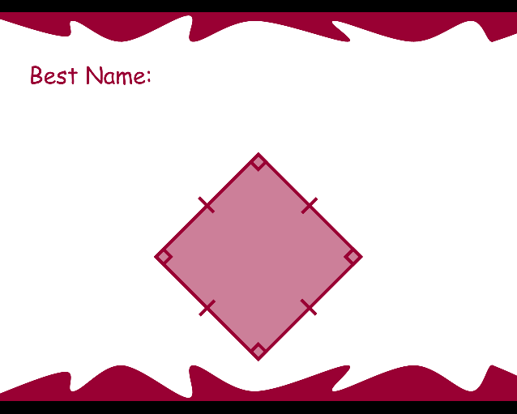
Square
A square is also a:
Parallelogram
Rhombus
rectangle

